Slide 1


Data Science System Project
Power Prediction Of Wind Turbine using pySpark
Team :
Daulat Kumar Jha - 20BCS037
Dhanist Kumar Jha - 20BCS037

Slide 2
Index
Introduction
Dataset
Algorithms
Working
Results
Conclusions

Slide 3
01
Introduction
In this data science project, you aim to predict wind turbine power production using a PySpark-based approach on a dataset containing information about wind speed, wind direction, month, hour, and power generation. After data preparation and feature engineering, we'll split the dataset, select and train regression models, evaluate their performance, and potentially fine-tune them. Wind direction can be converted into numerical values using trigonometric functions.

Slide 4
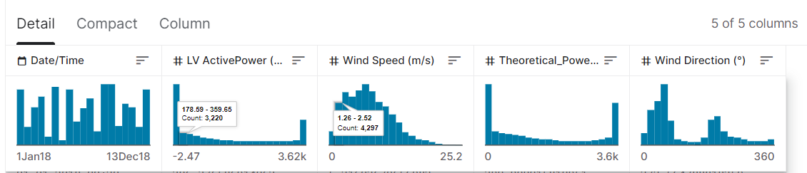
02
Dataset
The final model can be deployed for real-time or batch predictions, and you should document the entire process, including visualizing results and explaining feature importance.
50530+ Entries
Source: https://archive.ics.uci.edu/ml/datasets/forest+fire

Slide 5
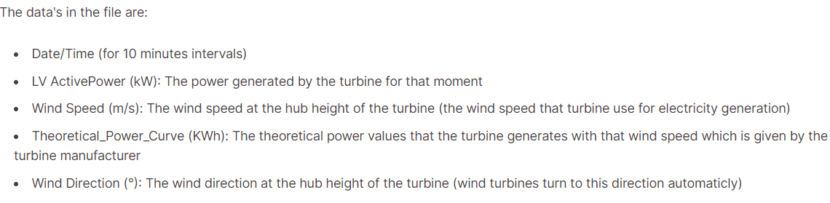
03
Dataset Features

Slide 6
04
Algorithm Used
Vector Assembler: Vector Assembler is a feature transformer commonly used in tools like PySpark. It is used to assemble or combine multiple feature columns into a single vector column. This is particularly useful when you want to prepare your data for machine learning models that expect a single input column. It is used for combining features and variables in our model.
GBT Regressor : Gradient Boosted Trees (GBT) Regressor is a machine learning algorithm used for regression tasks. It's a powerful ensemble learning method that combines the predictions of multiple decision trees to make accurate continuous predictions. GBT Regressor is a member of the gradient boosting family of algorithms, which are known for their high predictive accuracy and robustness.

Slide 7
05
Working
Vector Assembler
Mathematics: The Vector Assembler essentially stacks the values from the specified input columns into a single vector. For example, if 'month' is 3, 'hour' is 14, 'wind speed' is 7.5, and 'wind direction' is 120°, the assembler creates a vector [3, 14, 7.5, 120°].
Preparation for Machine Learning: By combining these features into a single vector, It’s preparing the data to be used with machine learning algorithms that require a single input column, such as the GBT Regressor. It simplifies the process of feeding data into the model.

Slide 8
05
Working Continued
GBT Regressor
GBT Regressor is an ensemble learning algorithm that combines multiple decision trees to make predictions. It operates sequentially, where each tree tries to correct the errors made by the previous ones.
Gradient of the Loss Function (dL/dy): To minimize the loss function, GBT computes the gradient of the loss with respect to the predicted values. This gradient represents the direction and magnitude of the error that needs to be corrected in the predictions.
F(x) = F_0(x) + η * f_1(x) + η * f_2(x) + ... + η * f_N(x)
Here,
F(x) = Function of GBT regressor
η = Learning rate
.

Slide 9
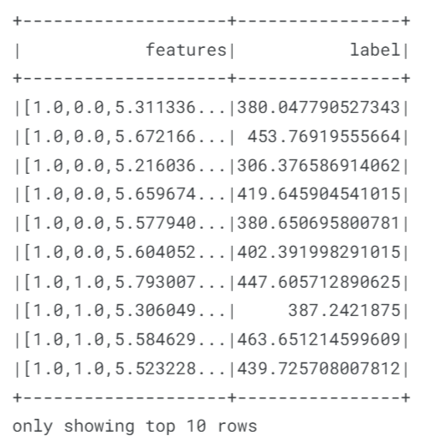
06
Implementation
Data preparation for the spark algorithm using vector assembler
vectorAssembler = VectorAssembler(inputCols = variables, outputCol = 'features')
va_df = vectorAssembler.transform(spark_df)

Slide 10
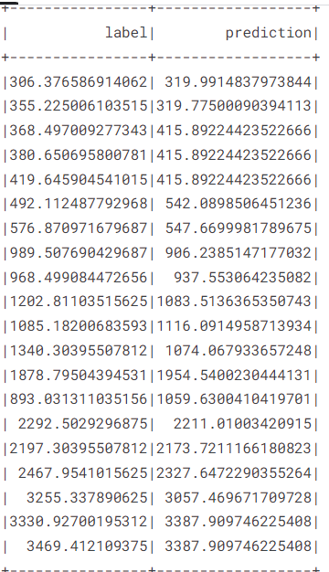
06
Implementation continued
Creating initial model using GBT Regressor:
gbm = GBTRegressor(featuresCol='features', labelCol='label')

Slide 11

06
Implementation continued
Evaluate model:
evaluator = RegressionEvaluator(predictionCol='prediction', labelCol='label')

Slide 12
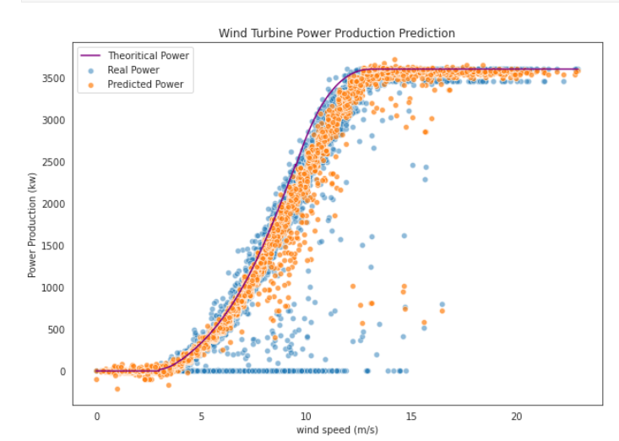
06
Implementation continued
comparing result:

Slide 13
07
Conclusion
The wind turbine power prediction project embarked on a journey to harness the potential of data-driven insights for the optimization of wind energy production. By employing machine learning techniques and the Gradient Boosted Trees (GBT) Regressor, we endeavored to forecast wind turbine power output based on crucial meteorological and temporal features, namely wind speed, wind direction, month, and hour.

Slide 14
Thank You

